Slide 1
ECONOMIC POLICY AFTER THE BAILOUT 31 January 2013
Beyond the choice v constraint debate: some key findings from a recent representative survey on emigration
ESRI/DEW/UL/UCD
Piaras Mac Éinrí, Department of Geography/Institute for Social Sciences in the 21st Century, University College Cork

Slide 2
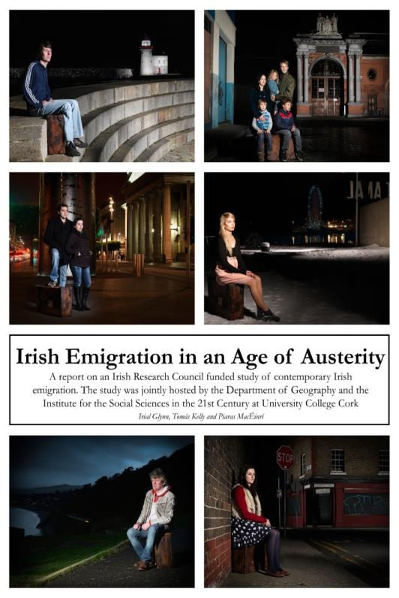
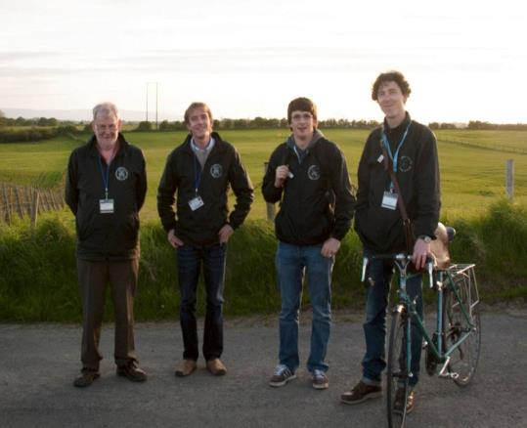

Slide 3
Emigre
Methodology

Slide 4
Goals of Research
Who is going
Why they left
Whether they intend to return
Who has been affected at home and how
Public perceptions of emigration and related issues

Slide 5
How Goals were achieved
Extensive literature review on relevant studies from 1930s to present
Nationwide household survey (2400+ households, 22 small areas, 12 counties)
Online emigrant survey (1500+ responses)
Jobsfair survey (500+ responses)
55 in-depth interviews with emigrants abroad via skype, viber and telephone

Slide 6
Mixed methods approach
Both quantitative and qualitative data collected
Generalisable
Descriptive
Accessible to a wide variety of audiences

Slide 7
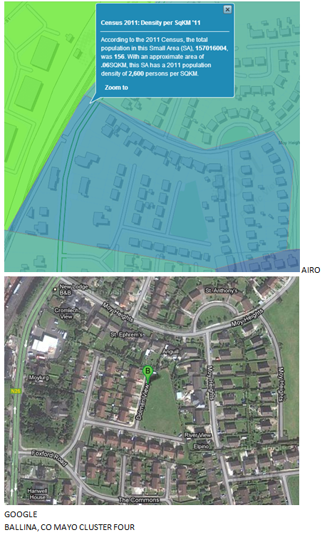
Sampling Strategy
Traditional random sample not methodologically feasible
>18,000 Small areas
Stratified Small areas into groups based on a Cluster analysis
Selected a series of typical Small areas from each Cluster to be visited
Notes:
At elast 100 Sas no matter what way you look at it

Slide 8
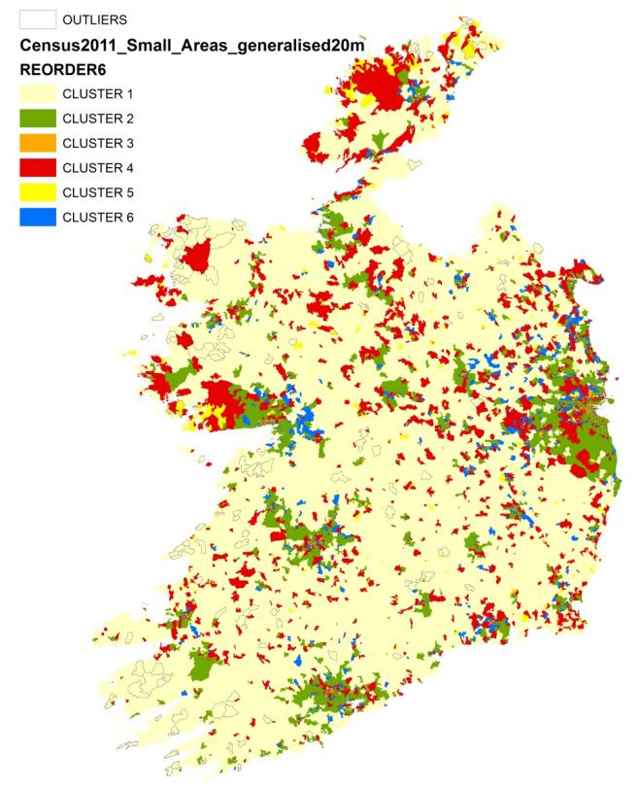
Clusters Identified
1: Sparsely populated rural areas (21%)
2: Affluent suburbs (19%)
3: Densely populated urban areas with a high concentration of young professionals (7%)
4: Established areas with mature populations & high household ownership (24%)
5: Densely populated areas with a high proportion of households rented from a local authority (12%)
6: Young families with mortgages living mainly in newer houses (17%)

Slide 9
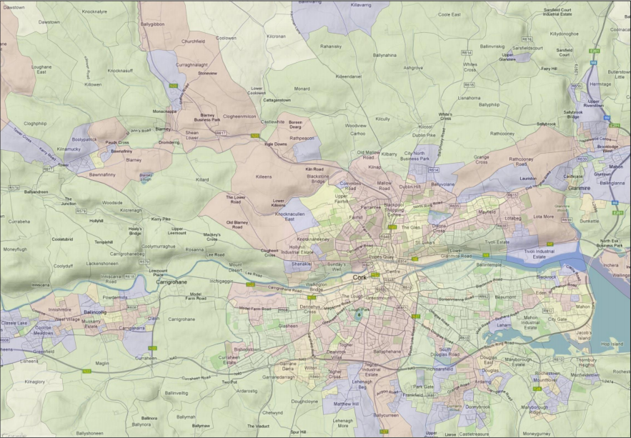
Cork

Slide 10
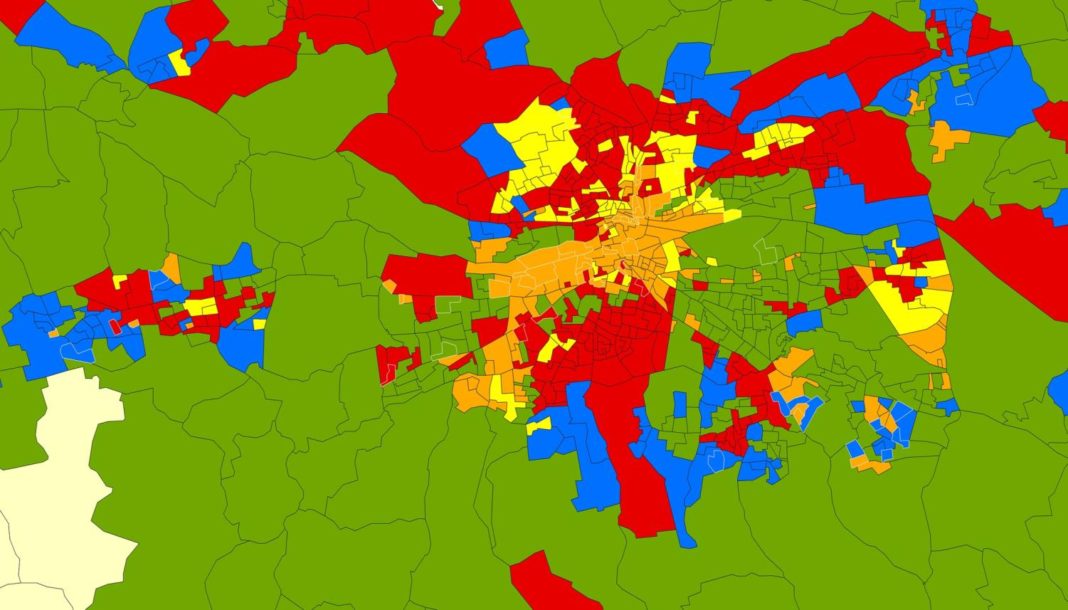

Slide 11
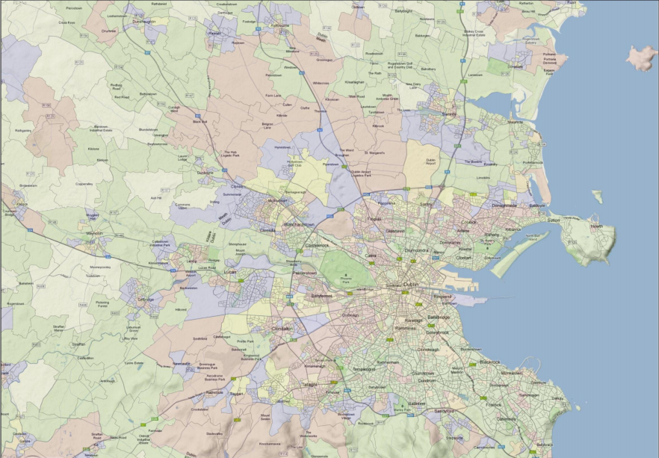

Slide 12
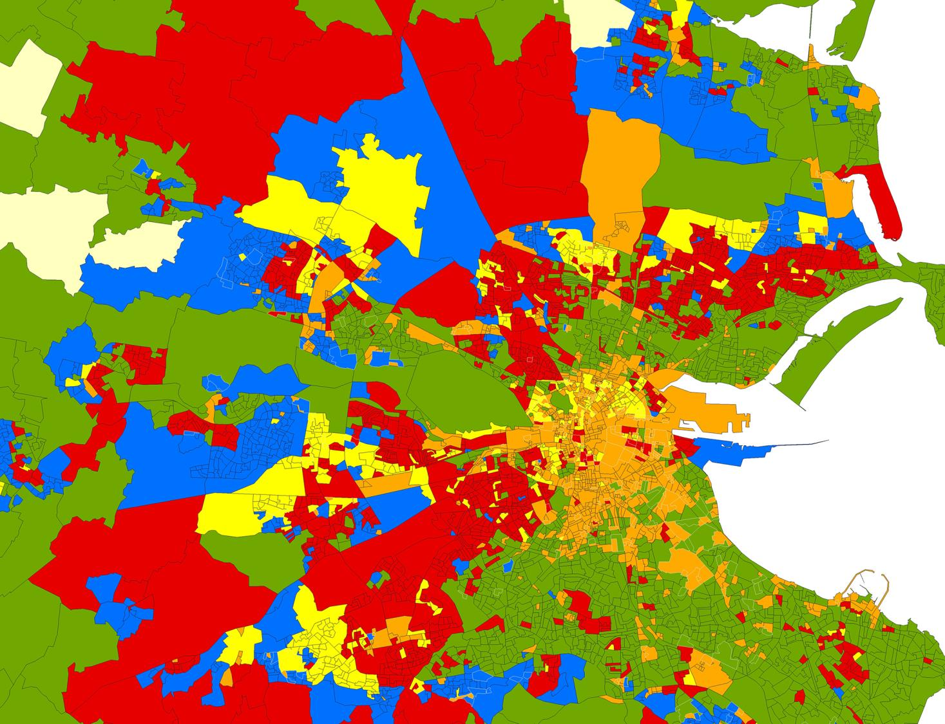

Slide 13
Cluster Analysis Sample
22 Small Areas
18 Counties
> 2,400 Houses
Representative?
Average 0.8%
difference across
62 variables
Variable | Difference between national average and sample average
Employed in Agriculture, Forestry and Fisheries | 0.98%
Houses owner occupied without a mortgage | -1.78%
Persons with ordinary level degree, national diploma or higher | 0.40%
Unemployment | 0.69%
Families with adult children | 0.32%
Persons aged 20 to 34 | 1.33%

Slide 14
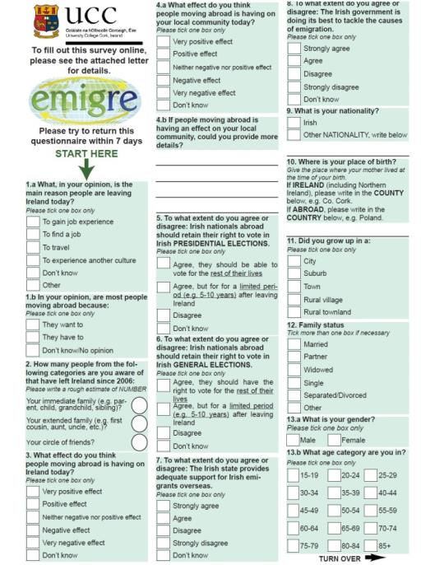
Questionnaire

Slide 15
Statistical Weighting
Household data weighted based on: Cluster membership, Number in household and Nature of occupancy
Data on individuals weighted at second stage based on age group and gender
Could not measure or control for positive response bias
Emigrants who left no one behind in household not identified
Weighted online responses based on education (household survey)
 | Average difference between national average and sample average | Maximum difference between national average and sample average
Cluster membership | 1.1% | 2.1%
Nature of Occupancy | 0.8% | 1.7%
Number of persons in Household | 0% | 0%
Age group | 0.1% | 0.4%
Gender | 0% | 0%

Slide 16
Emigre
Some Key Findings

Slide 21
Lifestyle choice for some
‘I was getting a bit tired of the same routine ... I just wanted to try something new really. … I didn’t feel it was a case of anything pushing me. It was much more a case of ... I always wanted to live abroad anyway.’ [Male, IT, 30-34, Australia]
[I] just wanted to experience other countries. It was not necessarily a question of being unhappy with my job or the sector. … I was interested in seeing other places.’ [Male, 30-34, Media, UK]

Slide 22
Average in Ireland: 3.9/10, Average abroad: 8/10

Slide 23
Ambition and job insecurity for others
‘[W]e were under so much pressure financially …[it] meant there wasn't the scope to be rewarded in any way or promoted. … It was a choice for me to leave but also it was because the job that I was in had very little prospects’ (Female, 25-29, Australia, Management)
‘I was temporary, I wasn’t permanent so I never knew when my last day was going to be. I was always in that position so that was another reason why I decided I needed to make myself permanent in a position somewhere.’ (Female, 20-24, Student, UK)

Slide 24
Reasons for departure

Slide 26
Work
‘I hadn’t worked in a few years so I had no choice really but to leave. … it was just driving me nuts at home every day. … I didn’t see any future there at all.’ (Male, 25-29, Carpenter, Australia)
‘I applied for a six month position and heard through the grapevine that there were 600 applicants … I hated being on the dole. I hated every second of it’. (Male, 30-34, Teacher, UK)
‘[T]here were people in their 40s applying to voluntary grad programmes just to get back to work. So it was very hard to get a job.’ (Female, 20-24, Mechanical Engineer, UK)

Slide 27
Average in Ireland: 5.5/10
Average abroad: 7.6/10
Average in Ireland: 5/10
Average abroad: 7.5/10
* NUMBERS ARE DERIVED ONLY FROM THOSE WHO WERE IN EMPLOYMENT

Slide 28
Average in Ireland: 5.5/10, Average abroad: 7.9/10

Slide 29
Emotional Costs
‘It’s broken my mother’s heart, it really has and my father as well I have to say.’ (Female 25-29, Administrator, New Zealand)
‘[L]ike my Mam was – she wasn't very sick – but she was pretty ill a couple of months ago. … It’s very difficult for families, especially close families.’ (Female, 30-34, Operations Assistant, Australia)
‘It’s been a total destruction of my life, my wife’s life, my two children’s lives. Mentally, I’m probably half-depressed all the time. … I just look forward to Christmas.’ (Male, 50-54, Engineer, Australia)

Slide 30
‘We are being left with a country of old people and very young people. Ireland is losing what is good about it.’ [Female, 35-39, Household Survey Respondent]
If you haven’t got educated youth what is the country going to do in the future? No one is going to be left to do the work – just pensioners.’ [Male, 70-74, Household Survey Respondent]

Slide 31
Footnote

