Slide 1
PILOT WORKSHOP
21/ October/2024
Promoting a Culture of Academic Integrity in Online Assessments through the Development of Instructional Tools: Perspective from a Multidisciplinary School,”
- A SATLE (Strategic Alignment of Teaching and Learning Enhancement) funded project.

Slide 2
INDEX
Introduction
Defining academic integrity
Purpose of workshop
Agenda of workshop
Zoom discussion

Slide 3
INTRODUCTION
ACADEMIC INTEGRITY IN UNSUPERVISED ASSESSMENT
Academic Integrity is about being honest and working independently in your studies.
Students, researchers, and staff achieve academic integrity through sound academic writing, avoiding plagiarism, and use of appropriate referencing and citation.
(2024, p.1, student code of conduct)

Slide 4
DEFINING ACADEMIC INTEGRITY
Academic Integrity can be defined as the implementation of six key values throughout your education (independent of the type of assessment)
Trust
Respect
Courage
Honesty
Fairness
Responsibility

Slide 5
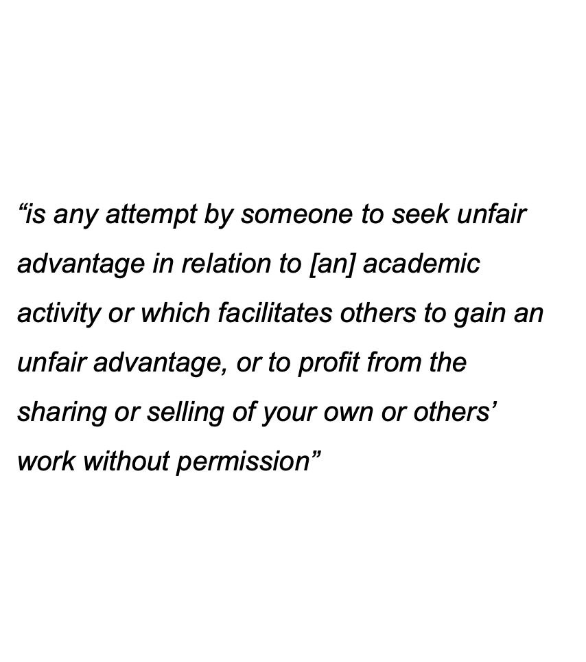

Slide 6
PURPOSE OF THIS WORKSHOP
Share your thoughts on academic integrity: We want to know what students think they need to enhance academic integrity in unsupervised assessments.
Discuss real-life situations: Critically evaluate real-world scenarios involving potential cheating, plagiarism, citation misuse, and collusion, distinguishing between ethical breaches and acceptable practices.
Connect core values of academic integrity to real situations: Recognise and relate the core values of Academic Integrity to real-world case scenarios.
Reflect on the importance of academic integrity: Share why academic integrity matters to you and your fellow students.
Identify support available for students

Slide 7
AGENDA OF THIS WORKSHOP
Breakout rooms
Scenarios
Discussion
Group discussion
Worksheet
You will be divided into groups or 2/3
You will be given one/two scenarios representing values of academic integrity
Discuss these scenarios with your group members and one can make some handwritten notes
Leave the breakout room and share the opinion/s and comment/s with all the participants
Finish the worksheet
10 minutes
30 minutes

Slide 8
LET’S BEGIN

