Slide 1
CHAPTER 5. EMOTIONAL INTELLIGENCE

Slide 2
LEARNING OBJECTIVES
Understand how emotional intelligence is conceptualized within positive psychology
Understand the main theories of emotional intelligence
Know how to assess ability and trait emotional intelligence
Identify the main research findings linking emotional intelligence to general intelligence, personality, job performance, wellbeing and health
Know about research on the impact of emotional intelligence training
Be able to engage in exercises designed to enhance emotional intelligence

Slide 3
EMOTIONAL INTELLIGENCE:
ABILITY OR PERSONALITY TRAIT?

Slide 4
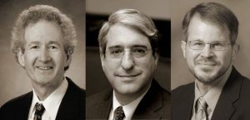

EMOTIONAL INTELLIGENCE - ABILITY OR PERSONALITY TRAIT?
Emotional intelligence (EI) has been conceptualised a set of abilities for processing emotional information, and as a set of personality traits reflecting how a person typically perceives, expresses & regulates their emotions
There are many measures of ability and trait EI. We will look at an example of each
Ability EI. Jack Mayer, Peter Salovey, and David Caruso, authors of the Mayer-Salovey-Caruso Emotional Intelligence Test (MSCEIT) conceptualised EI as a set of abilities
Trait EI. Reuven Bar-On, author of the first and second editions of the Emotional Quotient Inventory (EQ-I 2.0) conceptualised EI a set of personality traits
Jack Peter David
Mayer Salovey Caruso
Reuven
Bar-On

Slide 5
MAYER SALOVEY AND CARUSO
EMOTIONAL INTELLIGENCE TEST (MSCEIT) MODEL
Note: Based on Figure 5.2, p. 108 in Mayer, J., Salovey, P. & Caruso, D. (2000). Emotional intelligence as zeitgeist, as personality, and as a mental ability. In R. Bar-On & J. Parker (Eds), Handbook of emotional intelligence (pp. 92-117). San Francisco, CA: Jossey-Bass.

Slide 6
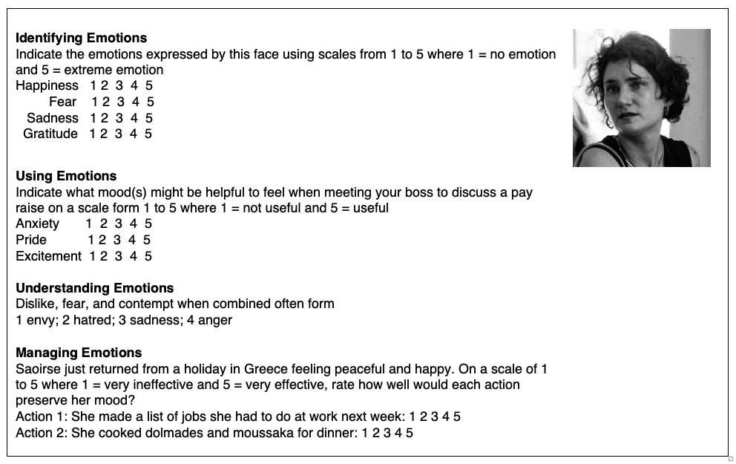
EXAMPLES OF MAYER SALOVEY AND CARUSO EMOTIONAL INTELLIGENCE TEST (MSCEIT) STYLE ITEMS

Slide 7
BAR-ON EQ-i 2.0 TRAIT EMOTIONAL INTELLIGENCE TEST
MODEL
Note: Based on the Bar-On model of emotional intelligence in Bar-On, R. (1997). Bar-ON Emotional Quotient Inventory: Technical Manual. Toronto, Canada: Multi-Health Systems; and Multi-Health Systems (2011). EQ-i 2.0 Emotional quotient inventory 2.0 user’s handbook. Toronto, Canada: Multi-Health Systems.

Slide 8
BAR-ON EQ-i 2.0 TRAIT EMOTIONAL INTELLIGENCE TEST
SAMPLE ITEMS
When I’m angry with others I can tell them about it
I know how to deal with upsetting problems
I like helping people

Slide 9
PAUSE & PRACTICE - EMOTIONAL INTELLIGENCE
Measurement of Emotional intelligence – Brief Emotional Intelligence Scale (BEIS-10) You may complete this questionnaire to assess your trait emotional intelligence. For each item circle the response that usually applies to you. Sum the scores for all 10 items. Scores range from 10 to 50. Higher scores indicate greater trait emotional intelligence
1 | I know why my emotions change | Strongly disagree 1 | Disagree 2 | Neither agree nor disagree 3 | Agree 4 | Strongly agree 5
2 | I easily recognize my emotions as I experience them | Strongly disagree 1 | Disagree 2 | Neither agree nor disagree 3 | Agree 4 | Strongly agree 5
3 | I can tell how people are feeling by listening to the tone of their voice | Strongly disagree 1 | Disagree 2 | Neither agree nor disagree 3 | Agree 4 | Strongly agree 5
4 | By looking at their facial expressions, I recognize the emotions people are experiencing | Strongly disagree 1 | Disagree 2 | Neither agree nor disagree 3 | Agree 4 | Strongly agree 5
5 | I seek out activities that make me happy | Strongly disagree 1 | Disagree 2 | Neither agree nor disagree 3 | Agree 4 | Strongly agree 5
6 | I have control over my emotions | Strongly disagree 1 | Disagree 2 | Neither agree nor disagree 3 | Agree 4 | Strongly agree 5
7 | I arrange events others enjoy | Strongly disagree 1 | Disagree 2 | Neither agree nor disagree 3 | Agree 4 | Strongly agree 5
8 | I help other people feel better when they are down | Strongly disagree 1 | Disagree 2 | Neither agree nor disagree 3 | Agree 4 | Strongly agree 5
9 | When I am in a positive mood, I am able to come up with new ideas | Strongly disagree 1 | Disagree 2 | Neither agree nor disagree 3 | Agree 4 | Strongly agree 5
10 | I use good moods to help myself keep trying in the face of obstacles | Strongly disagree 1 | Disagree 2 | Neither agree nor disagree 3 | Agree 4 | Strongly agree 5
Note: Reproduced with permission of Hogrefe Publishing from Table 4, page 204 in Davies, K. A., Lane, A. M., Devonport, T. J., & Scott, J. A. (2010). Validity and reliability of a brief emotional intelligence scale (BEIS-10). Journal of Individual Differences, 31(4), 198-208. https://doi.org/10.1027/1614-0001/a000028, Copyright © 2010 Hogrefe Publishing www.hogrefe.com

Slide 10
ABILITY & TRAIT EMOTIONAL INTELLIGENCE
ABILITY EI | TRAIT EI
Assessed with maximum performance tests (Complex tasks requiring skilled responses) | Assessed with typical performance tests (Self-report or observer-rated questionnaires, filled out by colleagues, parents, or teachers)
Items have right or wrong answers and indicate the upper limit of EI | Items allow informant to rate the extent to which items describe typical EI
Ability EI tests are like traditional IQ tests | Trait EI tests are like personality tests
Research on ability EI investigates how people process and use emotional information | Research on Trait EI investigates how to assess and enhance EI in schools and work organizations, and to select emotionally intelligent individuals for key organizational positions
Basic psychology | Applied psychology
 | Trait EI tests are also referred to as mixed-model frameworks, since the traits evaluated are a combination of personal attributes such as optimism, and skills such as emotional problem-solving

Slide 11
STRENGTHS & WEAKNESSES OF ABILITY & TRAIT EMOTIONAL INTELLIGENCE MEASURES & MODELS
ABILITY EI | TRAIT EI
Ability EI may be incorporated in widely accepted hierarchical models of general intelligence (e.g., Cattell-Horn-Carroll model) | Trait EI measures add very little to what established personality tests measure and predict, and so trait EI will not be easily incorporated into established models of personality traits (e.g., Five Factor model of Personality) Trait EI measures do not correlate highly with IQ and so will not be be easily incorporated into established models of general intelligence (e.g., Cattell-Horn-Carroll model)
Ability EI tests have no agreed criterion for correct answers (e.g., judgments by expert panels, or answers given by majority of standardization sample) | Trait EI measures are easy to score, as they are self-report or observer-rated instruments
Ability EI is narrowly defined and ability EI measures may fail to evaluate all aspects of EI | Trait EI is broadly defined and trait EI measures probably assess most aspects of the construct
Some ability EI tests are long, and arguably impractical to use in applied settings | Many trait EI tests are a practical length, and easy to administer in applied settings
Ability EI tests lack face validity when used in organizations for staff selection & development | Trait EI tests have good face validity when used in organizations for staff selection & development
Correlations between ability & trait EI measures are low, indicating a lack of consensus about the exact nature of EI | Correlations between ability & trait EI measures are low, indicating a lack of consensus about the exact nature of EI

Slide 12
DEVELOPMENT OF
EMOTIONAL INTELLIGENCE

Slide 13
INVESTMENT MODEL OF EMOTIONAL INTELLIGENCE DEVELOPMENT
In their investment model, Moshe Zeidner, Gerald Matthews, and Richard Roberts proposed that the development of emotional intelligence depends upon 3 factors
Genetically determined and biologically based temperament. Infants with difficult temperament may find it difficult to develop emotional intelligence
Rule-based learning of emotional competencies. Development of skills for recognizing, understanding, and managing emotions in the self and others occur in attachment relationships with parents, and interactions with peers and others, through processes such as modelling and reinforcement
Self-aware, strategic regulation of emotions. Strategies for regulating emotions in self and others develop through coaching by parents, teachers, peers and others, and exposure to the media and cultural influences

Slide 14
DEVELOPMENT OF EMOTIONAL COMPETENCE
Carolyn Saarni’s research shows that from infancy to adolescence there is a gradual increase in the sophistication of strategies used for emotional expression, regulation, and managing emotional give-and-take in relationships
Emotional expression
A gradual progression from non-verbal to verbal expression of emotions
A gradual increase in the experience, expression, and later, the inhibition of self-conscious emotions (e.g., shame & pride), and complex emotions (e.g., feeling guilt for feeling anger)
A gradual increase in managing emotional expression to convey a desired impression to others
Emotional regulation
A gradual progression from reliance on parents and carers to self-reliance for emotional regulation
A gradual increase in the number of emotion regulation strategies used and the sophistication of these
Cognitive, language, and moral development facilitate the development of sophisticated emotional regulation strategies
Managing emotional give-and-take in relationships
A gradual increase in perceiving, understanding, empathizing with, and anticipating emotions in others
A gradual increase in skills for managing authentic and false expressions of emotions in the self and others
A gradual increase in understanding and skill in using information about emotions, emotional scripts, and emotional self-disclosure to make and maintain friendships

Slide 15
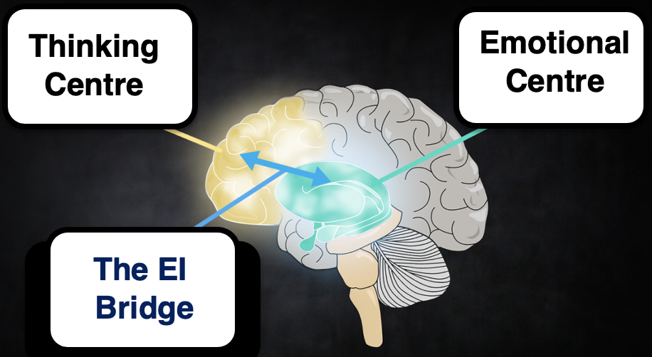
NEUROBIOLOGY OF EMOTIONAL COMPETENCE
Neural efficiency. Higher emotional intelligence is associated with greater neural efficiency, indicated by less activity in the prefrontal cortex when solving emotional problems - similar to the greater neural efficiency found in people with higher IQs when solving cognitive problems
The same brain circuits and patterns of neural efficiency are associated with trait and ability emotional intelligence
Circuits involving the prefrontal cortex, the amygdala, and the insula and cingulate cortex subserve emotional intelligence.
Thinking centre. The prefrontal cortex subserves the formation, regulation and management of emotional intelligence skills.
Emotional centre. The amygdala associates stimuli with emotional reactions
The EI bridge. The insula and cingulate integrate emotional and cognitive processes

Slide 16
EMOTIONAL INTELLIGENCE,
IQ,
BIG-5, &
JOB PERFORMANCE

Slide 17
Q & A - EMOTIONAL INTELLIGENCE, IQ, BIG-5, & JOB PERFORMANCE
Questions | Answers
What is the correlation between trait and ability EI? | Small, r = 0.26
Has ability EI a greater correlation than trait EI with IQ? | Yes, r = 0.25 v 0.11
Has trait EI a greater correlation than ability EI with big 5 personality traits? | Yes, r = 0.29-0.53 v 0.13-0.29
Has trait EI a greater correlation than ability EI with job performance? | Yes, r = 0.47 v 0.18
Have trait & ability EI a greater correlation with job performance for high v low emotional labour jobs? | Yes, r = 0.24-0.59 v 0.01-0.43

Slide 18
Q & A - EMOTIONAL INTELLIGENCE, IQ & JOB PERFORMANCE
Questions | Answers
Has trait EI a greater correlation than IQ with job performance? | Yes (but the difference is small), r = 0.47 v 0.44
Has ability EI a greater correlation than IQ with job performance? | No, r = 0.18 v r = 0.44
Has trait EI a greater correlation than IQ with job performance for high emotional labour jobs? | Yes, r = 0.59 v 0.37
Has ability EI a greater correlation than IQ with job performance for high emotional labour jobs? | No, r = 0.24 v 0.37
These findings partly support the claim made by Daniel Goleman in his best-selling book Emotional Intelligence: Why it Can Matter More Than IQ
Trait emotional intelligence can matter a little more than IQ in all jobs, and a great deal more than IQ in jobs involving high emotional labour

Slide 19
Q & A - EMOTIONAL INTELLIGENCE, BIG-5, & JOB PERFORMANCE
Questions | Answers
Has trait EI a greater correlation with job performance than any of the Big-5 personality traits? | Yes, r = 0.46 v 0.06-0.21
Has ability EI a greater correlation with job performance than any of the Big-5 personality traits? | No, r = 0.18 v r = 0.06-0.21 Conscientiousness is the only big-5 trait with a greater correlation with job performance than ability EI, r = 0.18 v 0.21
Have ability & trait EI greater correlations than any of the Big-5 personality traits with job performance for high emotional labour jobs? | Yes, r = 0.24-0.59 v 0.09-0.20

Slide 20
WHY DOES TRAIT EI PREDICT JOB PERFORMANCE?
Dana Joseph & Daniel Newman, in a large meta-analysis, found that trait EI predicts job performance well, because the content of measures of trait emotional intelligence overlaps with the content of seven well-established constructs known to predict job performance
IQ
Ability emotional intelligence
Self-rated performance
Conscientiousness
Emotional stability (or low neuroticism)
Extraversion
Self-efficacy

Slide 21
HOW DO ABILITY EI, IQ & BIG 5 PERSONALITY TRAITS CONTRIBUTE TO JOB PERFORMANCE?
Dana Joseph & Daniel Newman’s cascading model integrates theoretical frameworks and empirical findings on the effects on job performance of
Ability EI (emotional regulation, understanding, and perception)
IQ
Personality traits (Conscientiousness & Emotional stability [or low neuroticism])
In this model (on the next slide)
Job performance is proximally affected by emotional regulation
The precursors of emotional regulation are perceiving emotions in the self and others and understanding these emotions
These three facets of emotional intelligence (regulation, understanding, and perception) which affect job performance are influenced by cognitive ability (IQ), conscientiousness, and emotional stability (2 of the big-5 personality traits)
Conscientiousness affects emotional perception, since people with this trait are good at detecting personal emotions and impulses and controlling these
Cognitive ability affects emotional understanding, since clever people are better at understanding complex emotions
Emotional stability affects emotional regulation, since more emotionally stable people have a greater capacity for self-regulation

Slide 22
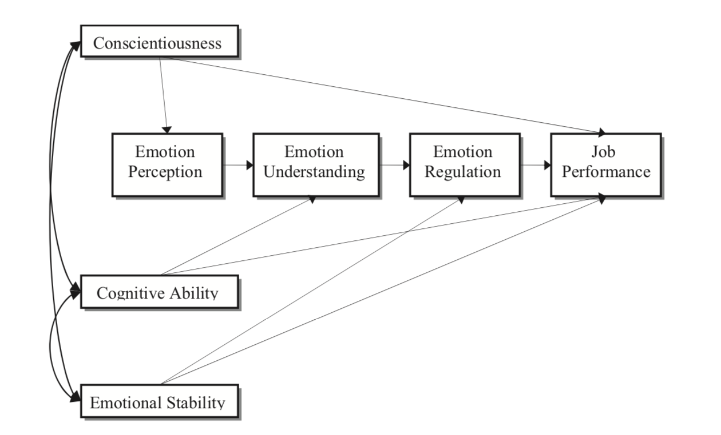
JOSEPH AND NEWMAN’S CASCADING MODEL OF
EMOTIONAL INTELLIGENCE AND JOB PERFORMANCE
Note: Reproduced with permission of the American Psychological Association from Figure 1, p. 56 in Joseph, D. L., & Newman, D. A. (2010). Emotional intelligence: An integrative meta-analysis and cascading model. Journal of Applied Psychology, 95(1), 54-78. https://doi.org/10.1037/a0017286, Copyright © 2010 American Psychological Association. Permission conveyed through Copyright Clearance Center, Inc.

Slide 23
EMOTIONAL INTELLIGENCE,
WORK ATTITUDES & BEHAVIOUR &
ACADEMIC PERFORMANCE

Slide 24
Q & A - EMOTIONAL INTELLIGENCE, WORK ATTITUDES & BEHAVIOUR, & ACADEMIC PERFORMANCE
Questions | Answers
Is EI correlated with job-satisfaction, work attitudes, and organizational behaviour? | Yes Employees with greater EI are more satisfied at work, more committed to their organizations and less likely to have intentions to leave Trait and ability EI are positively correlated with organizational citizenship behaviour and negatively correlated with counterproductive work behaviour
Do effective leaders have greater EI? | Yes EI is correlated with transformational leadership, constructive conflict management, & employee job satisfaction
Is EI correlated with academic performance? | Yes, r = 0.20

Slide 25
EMOTIONAL INTELLIGENCE &
POSITIVE ADJUSTMENT

Slide 26
Q & A - EMOTIONAL INTELLIGENCE & POSITIVE ADJUSTMENT
Questions | Answers
Is EI correlated with wellbeing? | Yes, r = 0.32
Is EI correlated with mindfulness? | Yes, r = 0.48
Is EI correlated with physical health? | Yes, r = 0.27
Is EI correlated with mental health? | Yes, r = 0.36
Is EI correlated with romantic relationship satisfaction? | Yes, r = 0.32

Slide 27
EMOTIONAL INTELLIGENCE TRAINING
IN SCHOOLS

Slide 28


EFFECTIVENESS OF EMOTIONAL INTELLIGENCE TRAINING IN SCHOOLS
Meta-analyses by Joseph Durlak show that school-based Social Emotional Learning (SEL) programmes
Had medium effects on social and emotional skills
Had small effects on prosocial behaviour and academic performance
Continued to have positive effects 18 years after intervention
Better outcomes occurred in programmes that
Had explicit learning goals
Used a step-by-step training approach
Used active forms of learning
Gave sufficient time for skills development
Were implemented as programme designers intended

Slide 29

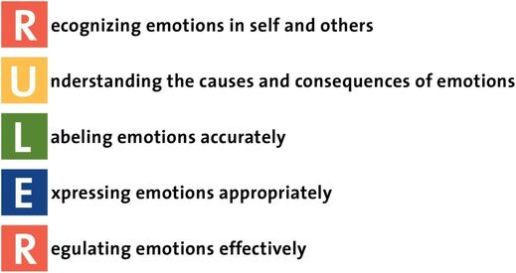
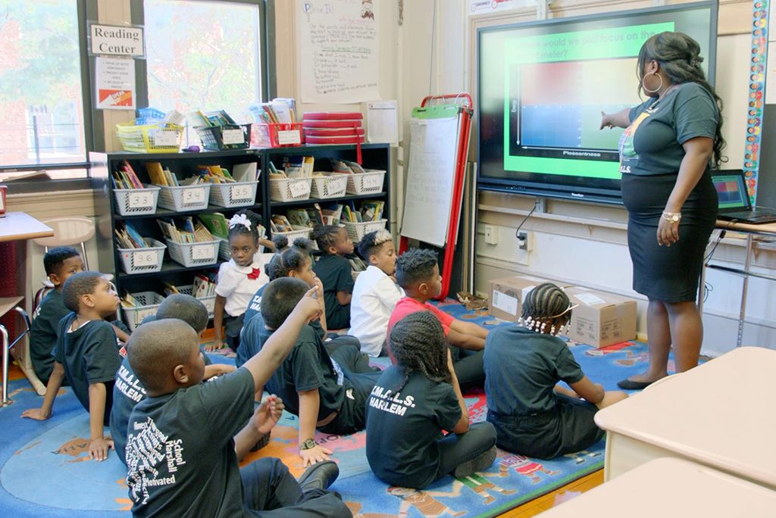
RULER
EMOTIONAL INTELLIGENCE TRAINING IN SCHOOLS
RULER was developed by Mark Brackett at Yale University and is an example of EI training is schools
RULER is an acronym for five key emotion skills which the programme facilitates in teachers, children and adolescents:
Mark Brackett

Slide 30
RULER
EMOTIONAL INTELLIGENCE TRAINING IN SCHOOLS
Four key interventions in the RULER programme
Charter. An aspirational statement
Mood meter. A 4 quadrant grid for naming emotions
Meta-moment. A 4-step strategy for regulating emotions in difficult situations
Blueprint. A strategy for managing conflict and restoring a positive climate

Slide 31
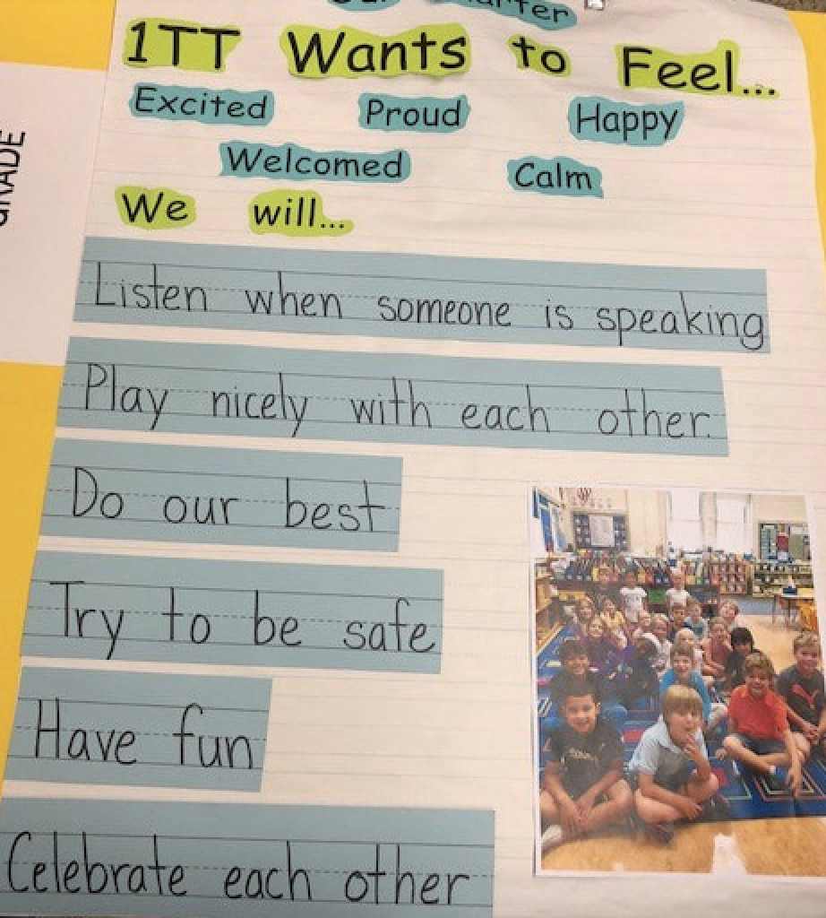
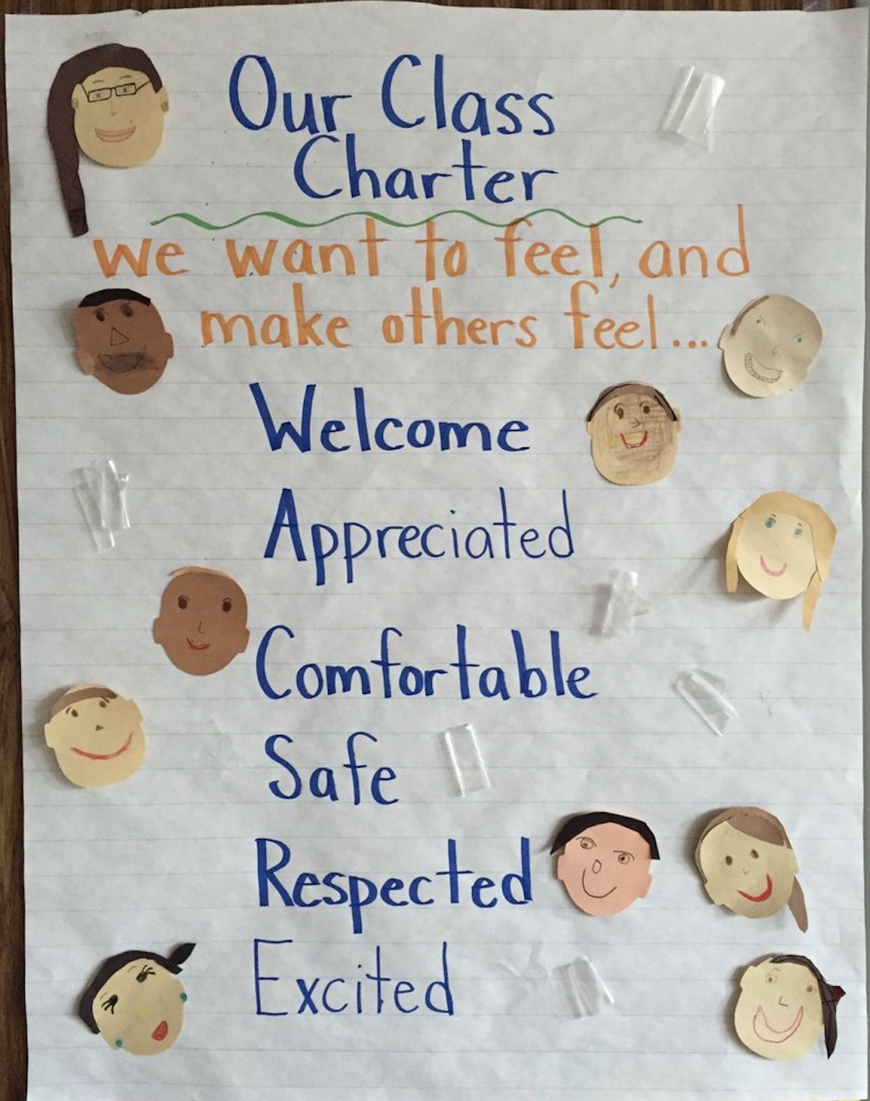
RULER CHARTER
EMOTIONAL INTELLIGENCE TRAINING IN SCHOOLS
Charter is an inspirational statement that all members of the school contribute to by addressing two key questions
How do we want to feel?
How do we ensure that everyone has these feeling?

Slide 32
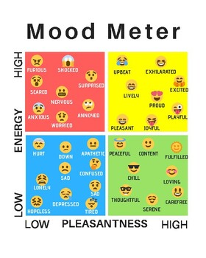
RULER MOOD METER
EMOTIONAL INTELLIGENCE TRAINING IN SCHOOLS
Mood meter. Is a 4 quadrant grid for naming emotions by
Colour
high/low energy
High/low pleasantness
Positive high energy emotions are yellow, e.g. happy
Positive low energy emotions are green, e.g. relaxed
Negative high energy emotions are red, e.g. angry and frightened
Negative low energy emotions are blue, e.g. sad

Slide 33
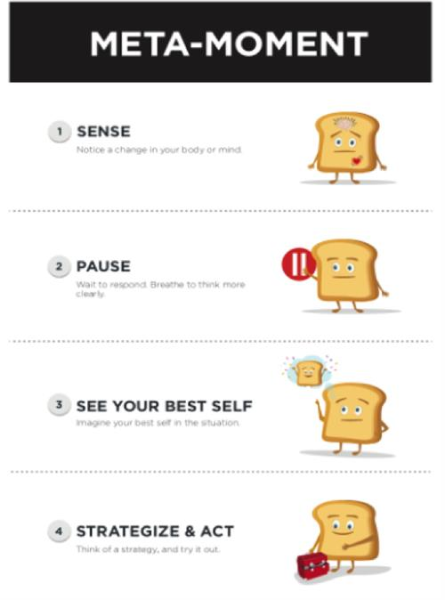
RULER META-MOMENT
EMOTIONAL INTELLIGENCE TRAINING IN SCHOOLS
Meta-moment. A 4-step strategy for regulating emotions in difficult situations.
Sense the emotion by noticing shifts in cognition, physiology, and behaviour.
Pause and breathe
See your best self in your mind’s eye
Strategize & act. Choose and use a helpful emotion regulation strategy before acting

Slide 34
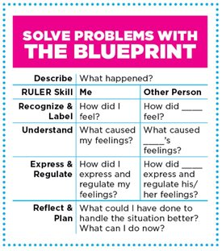
RULER BLUEPRINT
EMOTIONAL INTELLIGENCE TRAINING IN SCHOOLS
Blueprint. A strategy for managing conflict and restoring a positive climate by both people asking themselves
How did I feel?
What caused my feelings?
How did I express and regulate my feelings?
How did you feel?
What caused your feelings?
How did you express and regulate their feelings?
Answering these questions brings self-awareness & empathy
Then ask 2 more questions
What could I have done to handle the situation better?
What can I do now?

Slide 35
EMOTIONAL INTELLIGENCE TRAINING AT WORK

Slide 36





EFFECTIVENESS OF
EMOTIONAL INTELLIGENCE TRAINING AT WORK
Meta-analyses have shown that EI training leads to increases in EI post treatment and at follow-up for frontline employees and managers in a range of industries including
Retail
Banking
Law enforcement
Teaching
Health care

Slide 37
EMOTIONAL INTELLIGENCE TRAINING AT WORK
Consortium for Research on Emotional Intelligence in Organizations guidelines for promoting EI in the workplace
Organizational needs assessment. Assess the organization’s needs by determining the EI competencies essential for effective job performance, e.g. perceiving, understanding, using and managing emotions
Individual assessment & feedback. Conduct individual assessments and give feedback to staff on EI competencies they need to develop to improve job performance in a supportive environment
Goal setting & training. Invite staff to to set their own goals, participate in EI training, and link training goals to staffs’ personal values to increase their motivation
Positive relationships. Foster a positive relationship between trainers and staff, and among staff groups so they can support each other throughout training
Active learning. Use active, experiential methods to help staff learn emotional intelligence competencies and encourage self-directed learning

Slide 38
EMOTIONAL INTELLIGENCE TRAINING AT WORK
Skills modelling. Use live or videotaped models to demonstrate using EI competencies in work situations
Skills practice & feedback. Invite staff to practice EI skills and give constructive feedback within training sessions
Review skill use. Invite staff to use EI skills between training session and review progress within training sessions
Lapses as opportunities. Invite staff to view lapses and mistakes, not as failures, but as opportunities to refine their EI skills
Learning culture. Develop a culture that supports learning new skills.
Evaluation. Evaluate EI training programmes, by assessing staff before and after training and at regular follow-up times using
EI scales
Measures of job performance
Other ‘hard’ indicators such as absenteeism

Slide 39
PAUSE & PRACTICE – ENHANCING EMOTIONAL INTELLIGENCE
BY SETTING EMOTIONAL GOALS
Answer these questions and in doing so consider your life with your family, your friends, and your education or work situation:
How do you want to feel?
How do you want others to feel?
What are the main things you will do to achieve these emotional goals?

Slide 40
PAUSE & PRACTICE – ENHANCING EMOTIONAL INTELLIGENCE
BY MONITORING EMOTIONS
Keep a diary of mood change episodes.
For each episode note
The Activity that led to the change in mood
The Beliefs that led to the change in mood and
The Consequent mood change
Rate mood changes on
A 10 point scale for intensity from 1 = low intensity to 10 = high intensity
A 10 point scale for pleasantness from 1 = very unpleasant to 10 = very pleasant
Name the emotion. Here are some examples
High intensity positive emotions: Excited, Happy, Optimistic, Motivated
Low intensity positive emotions: Relaxed, Content, Grateful, Loving
High intensity negative emotions: Angry, Stressed, Frightened, Shocked
Low intensity negative emotions: Depressed, Sad, Pessimistic, Lonely

Slide 41
PAUSE & PRACTICE – ENHANCING EMOTIONAL INTELLIGENCE
BY HANDLING DIFFICULT SITUATIONS
Identify the emotion by noticing changes in how you feel, what you are thinking and your behaviour
Pause and take three deep breaths, breathing in for 3 and out for 6
Bring to mind an image of your best self, that is, the person you really want to be
Choose and use a helpful strategy for manging your emotions before impulsively acting on your negative emotions
Here are some examples
Breathe deeply in for 3 and out for 6 and allow yourself to fully experience and tolerate the distress caused by the difficult emotions you are experiencing, noticing that as you do so they become less intense
Think of a more positive way, or a humorous way of viewing the situation
Distract yourself by doing something else
Leave or take-time out from the difficult situation
Get support from a friend

Slide 42
PAUSE & PRACTICE – ENHANCING EMOTIONAL INTELLIGENCE
HANDLING CONFLICT
Clarify how you felt during the conflict by answering these questions:
How did I feel?
What caused my feelings?
How did I express and regulate my feelings?
Clarify how you think the other person felt during the conflict by answering these questions:
How did the other person feel?
What caused their feelings?
How did they express and regulate their feelings?
Reflect on what you have learned and make a plan by answering these questions:
What could I have done to handle the situation better?
What can I do now?

Slide 43
CONTROVERSIES ABOUT
EMOTIONAL INTELLIGENCE

Slide 44
CONTROVERSIES ABOUT EMOTIONAL INTELLIGENCE
EI is not a valid concept. Critics of EI, such as Edwin Locke, argue that the concept is invalid because
It is not a form of intelligence as conceptualised in mainstream theories of intelligence and assessed by IQ tests
It is defined so broadly and inclusively that it has no intelligible meaning
EI is not a valid cognitive ability. Critics of the ability model of EI point out that unlike IQ tests, correct answers to ability emotional intelligence tests are defined as those endorsed by the majority of respondents, a panel of expert researchers, or by reference to a particular theory of emotions These procedures yield scores that may reflect vocabulary size, conformity to social norms, or theoretical knowledge about emotions – not the ability to process emotional information
EI is not a valid personality trait. Critics of the trait EI point out that trait EI tests assess very little that is not assessed by big five personality trait inventories – EI is old wine in new bottles
EI should / should not include moral behaviour. Some argue that EI should include the ability to resist social pressure to conform to social norms in societies that uphold slavery, apartheid, or Nazism. Opponents propose that there may be narcissistic, Machiavellian and psychopathic individuals who have well-developed EI skills for perceiving the emotional Achilles heels of others, and for using these skills to exploit and manipulate others in unethical ways

