Slide 1
Group 3 Presentation
The Mystery of the Bermuda Triangle
Liping Shen
Omer Afzal
Michael Redmond

Slide 2
What is the Bermuda Triangle?
Aircraft and surface vessels have disappeared under mysterious circumstances

Slide 3
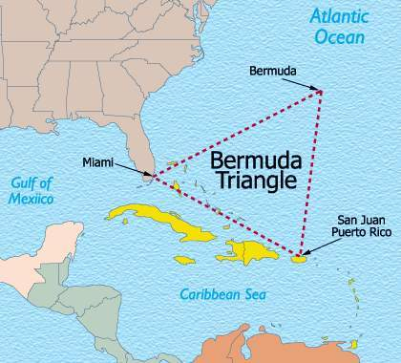
Whereabouts is it?
It’s an imaginary triangular area between Miami, Bermuda and Puerto Rico

Slide 4
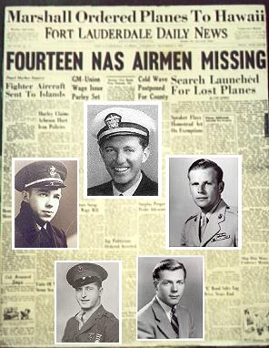
The Birth of the Bermuda Triangle Mystery
After the Flight 19 disappearance on December 5th 1945, the loss of five bombers led to a media hype which began speculation about the mystery of the triangle
Notes:
On December 5, 1945, Five Navy Avenger bombers mysteriously vanished while on a routine training mission, as did a rescue plane sent to search for them — six aircraft and 27 men, gone without a trace. As a result of this incident, the Bermuda Triangle was brought into the limelight

Slide 5
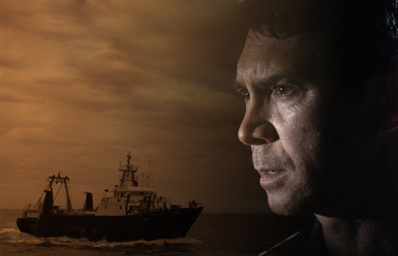
Odd - Missing ships, planes and sailors
Over 1,500 people have disappeared in the Bermuda Triangle area in the past 60 years.
Notes:
Ever since old times, reports have been accumulated about missing sailing ships and sailors. In modern times, planes and pilots also got lost. Over 1,500 people have disappeared in the Bermuda Triangle area in the past 50 years.

Slide 6
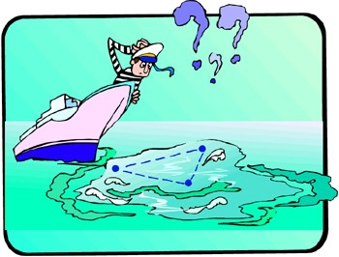
It seemingly has an endless appetite for aircrafts and ships.
Where did they go?

Slide 7
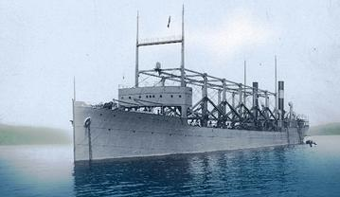
Notable Historical Incidents
1) USS Cyclops
The most notable first incident was USS Cyclops. The ship along with 309 crew members went missing on March 4, 1918

Slide 8
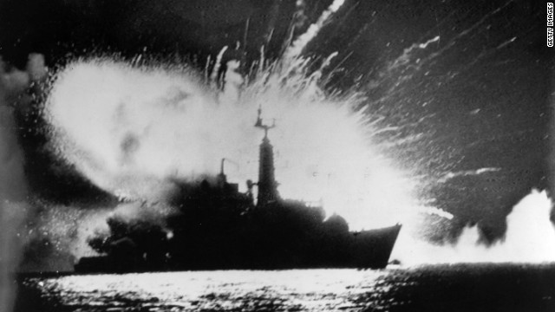
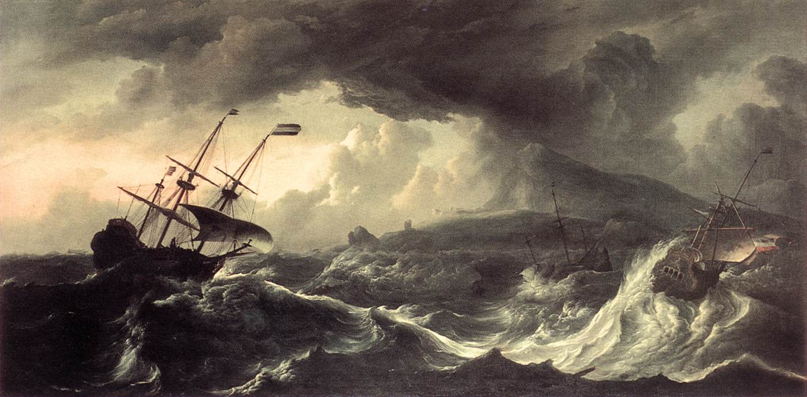
Possible causes:
German Conspiracy
Over-loading and Capsizing

Slide 9
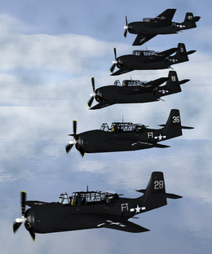
2) Flight 19
One of the greatest mysteries of the Bermuda Triangle is Flight 19. On December 5, 1945 at 2:10 pm five Avenger bombers disappeared flying over the Atlantic

Slide 10
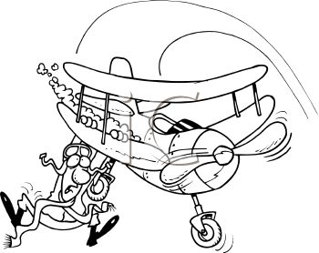
Last transmission from flight 19
At 4:45 One of the pilots said, " Damn it, if we could just fly west we would get home; head west, damn it"

Slide 11
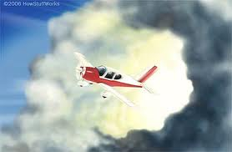
An Incredible Electronic fog

Slide 12
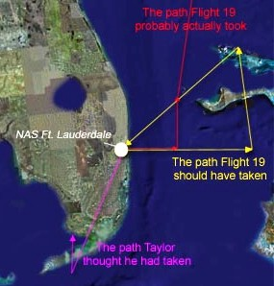
Human error
At 4:45 pm, James was instructed to handover the control to his students, but he did not listen

Slide 13
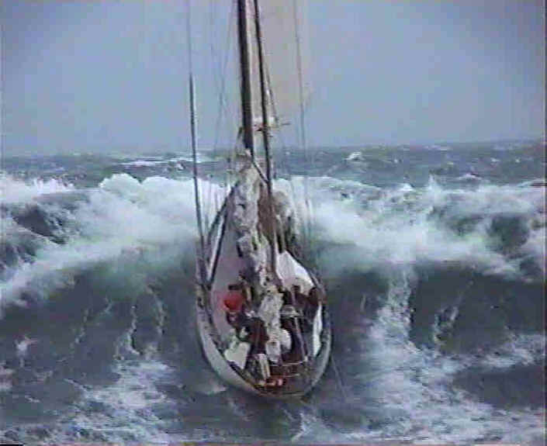
3) Ghost Ships
A pleasure yacht was found adrift in the Atlantic south of Bermuda on September 26, 1955. All three guys missing. Infamous hurricane “Lone” hit the yacht on 14th and 18th of September.

Slide 14
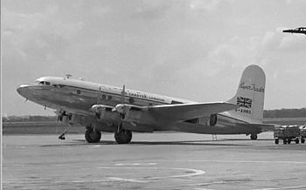
4) Star Tiger & Star Ariel
Both the planes disappeared in consecutive years 1948 and 1949, while flying over Bermuda

Slide 15
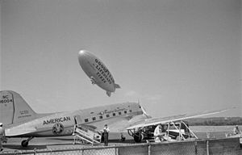
5) Douglas Airline
The plane and all 28 members went missing mysteriously while flying from Puerto Rico to Florida in 1948

Slide 16
No one knows !!
Many incidents, many books, massive research with no substantial evidence

Slide 17
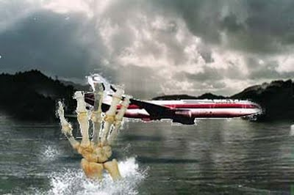
Theories
Realistic and Unrealistic
13 major theories in total
Notes:
There are a number of theories that explain the disappearances and happenings in the Bermuda Triangle.
They are both realistic and unrealistic, some of them very unrealistic!
There are 13 major theories in total.

Slide 18
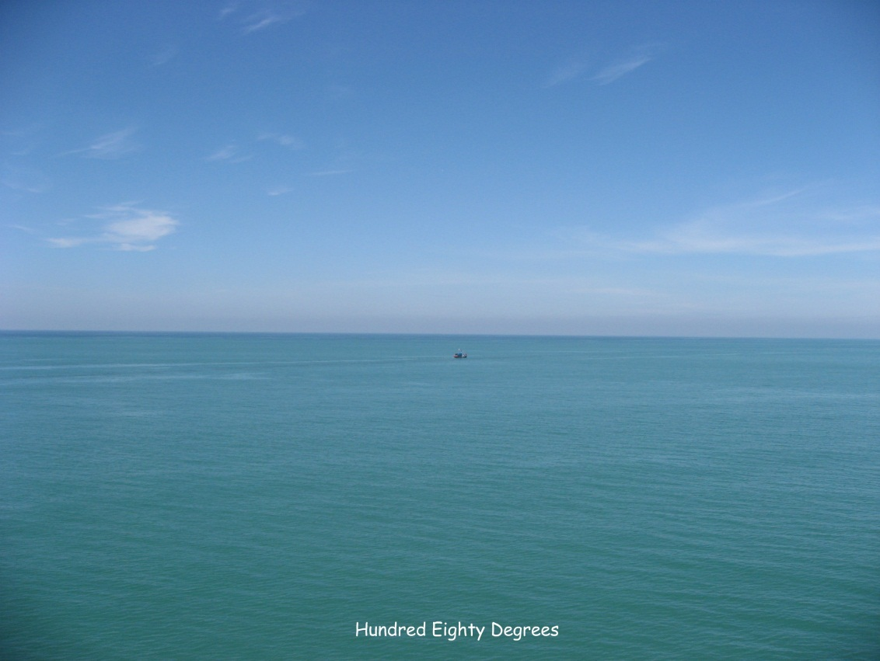
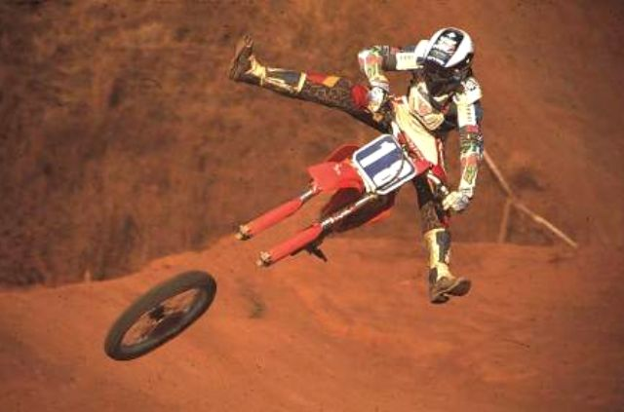
Human Error
Notes:
Human error / pilot disorientation –
The triangle area is an incredibly busy trading route for both ships and planes. This means lots of traffic and lets face it, everyone makes mistakes!
The landscape of the triangle is also composed of lots of similar looking islands and reefs and due to the fantastic weather of the Caribbean, sometimes the sea and the sky can look very similar.
Some planes have actually crashed straight into the sea due to this!

Slide 19
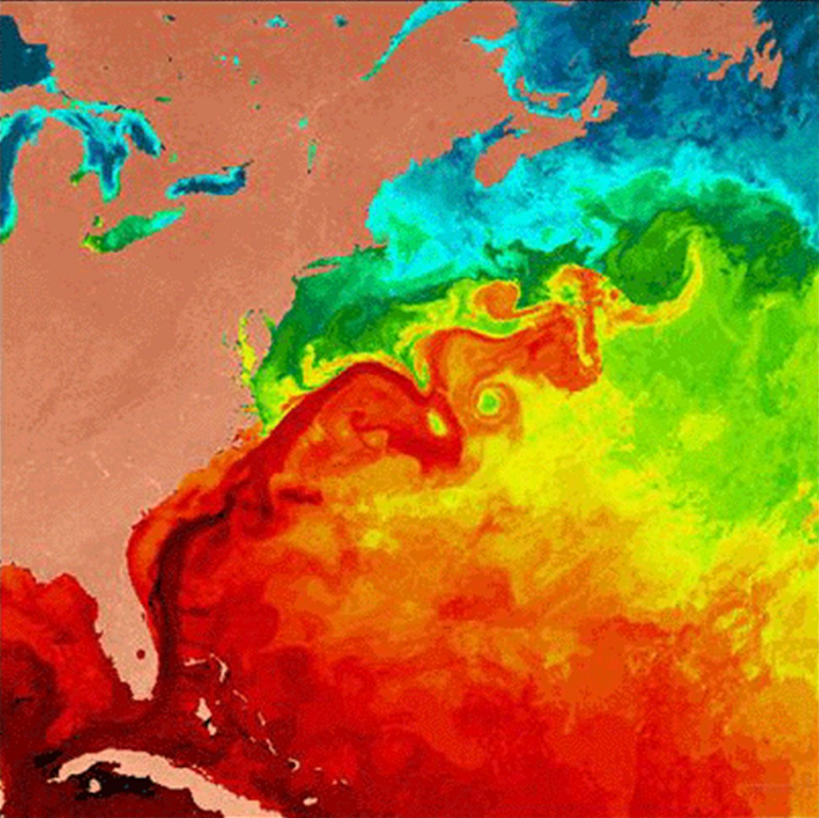
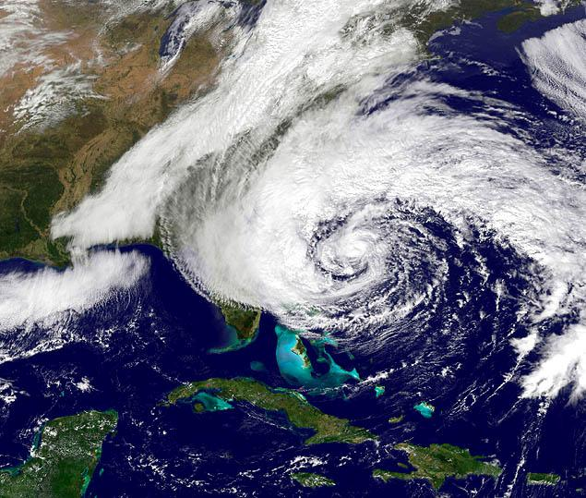
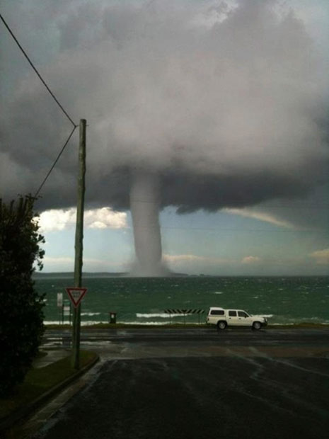
Crazy weather patterns
Notes:
The Bermuda Triangle is smack bang in the centre of hurricane alley. This area is prone to hurricanes, atlantic storms and other crazy weather.
It is also prone to waterspouts which have been known to sink small ships and other surface vessels.
The triangle is also home to the gulf stream, one of the strongest ocean currents in the world. Any ships or planes that sink here will be carried away by the current and could be displaced by hundreds of miles making finding these wrecks near to impossible.

Slide 20
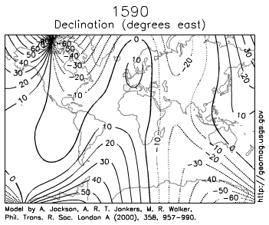
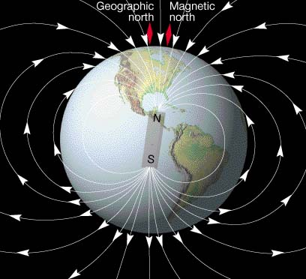
Compass Variation
Notes:
As you all might know magnetic north and geographic north are in different places.

Slide 21
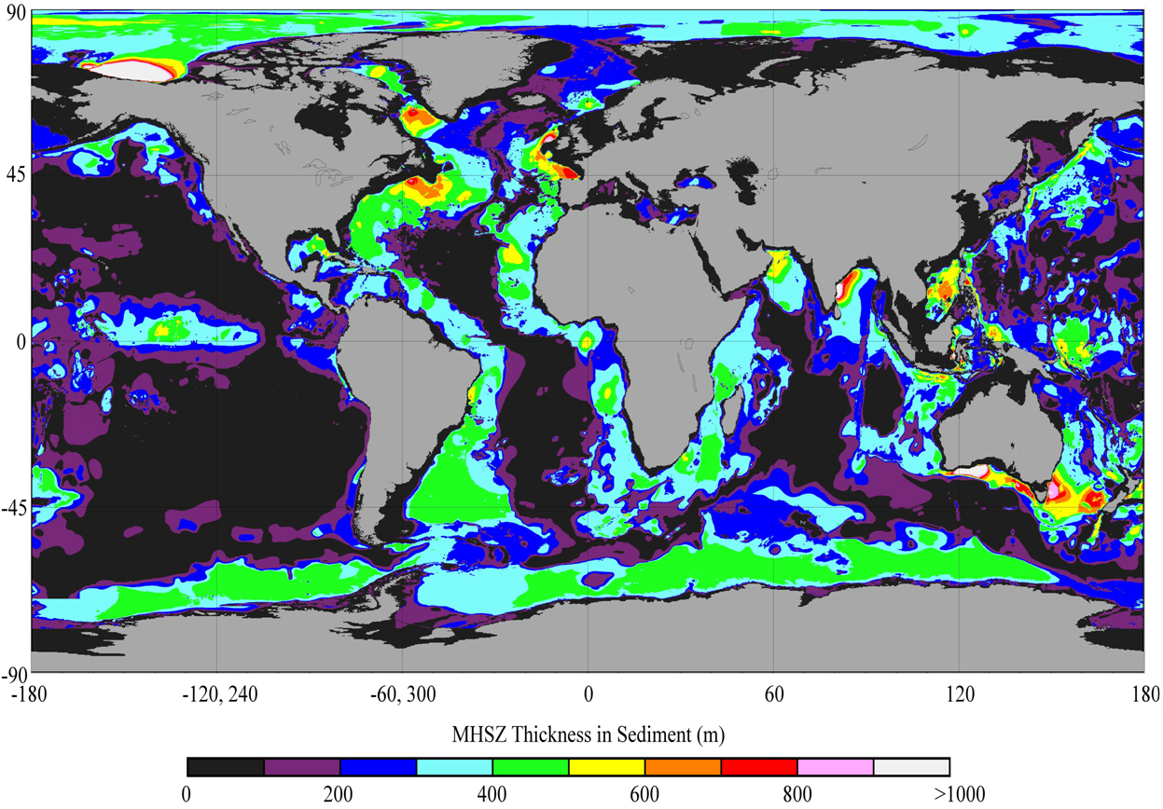
Methane Hydrates

Slide 22
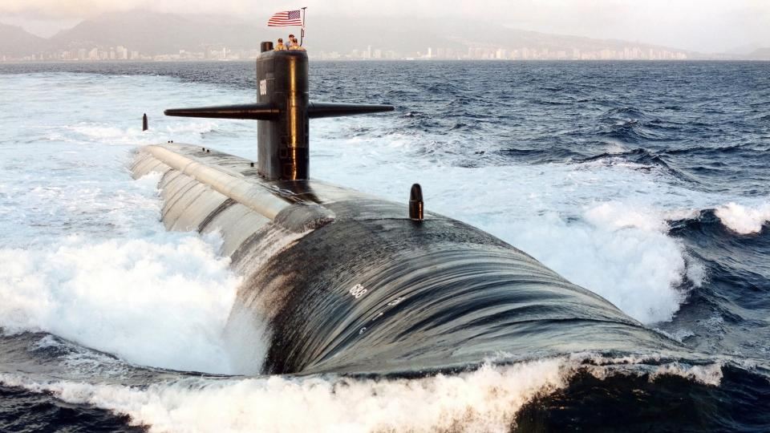
Government Testing
?

Slide 23
Pirates

Slide 24
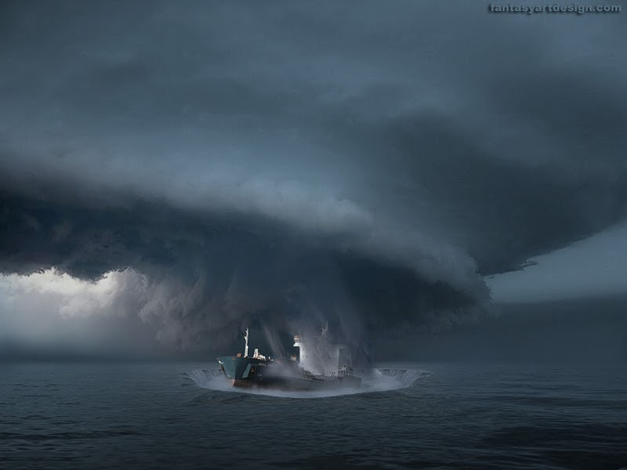
Wormhole

Slide 25
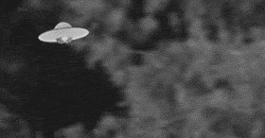
UFO/Aliens

Slide 26
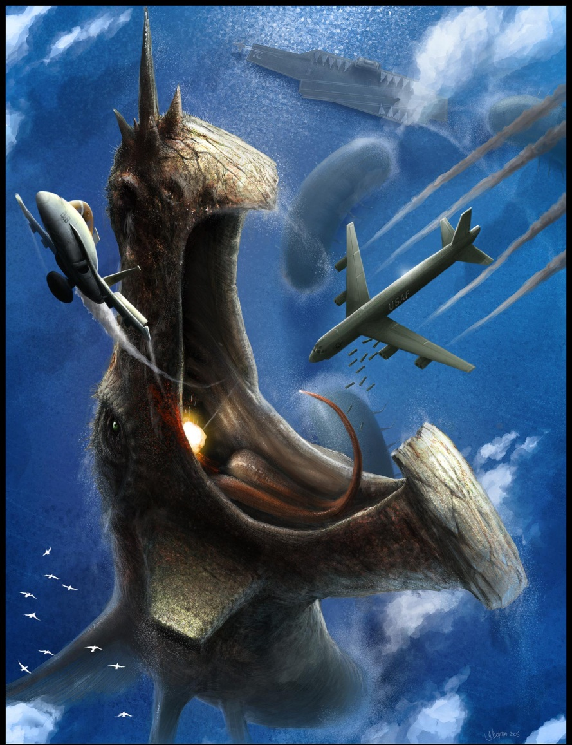
Bermuda Triangle Monster

Slide 27
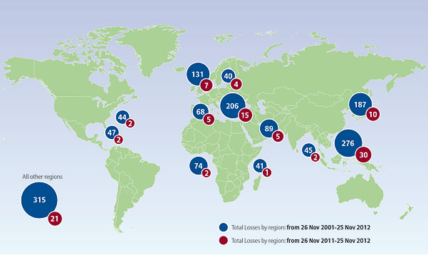
In relation to the rest of the world……

Slide 28
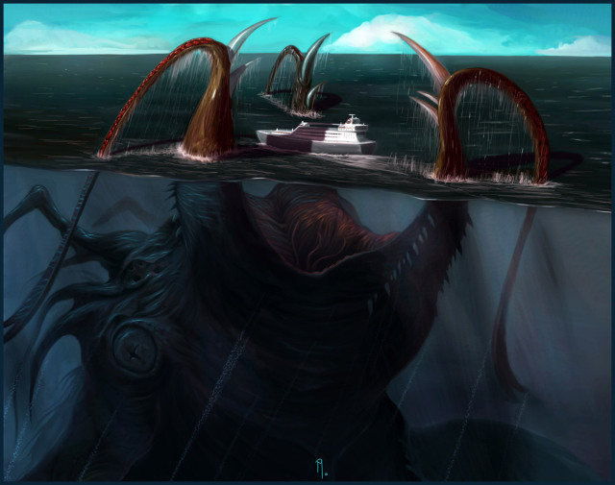
What we think………
haha NO
Monster

Slide 29
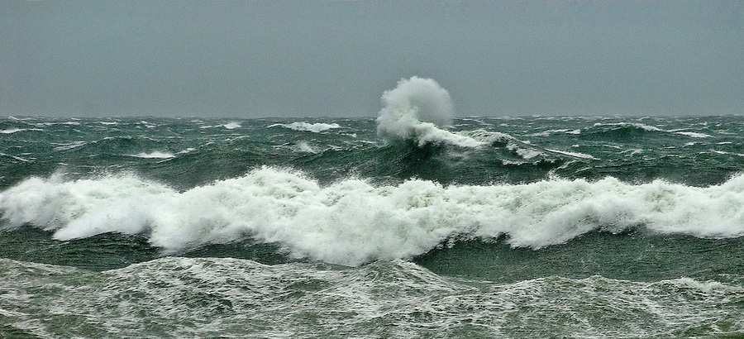
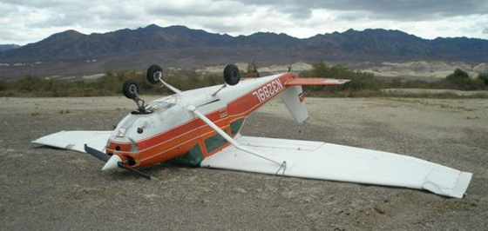
What we really think
Weather
Human Error

Slide 30
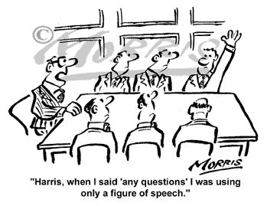
Thanks for listening
Questions?

